Slide 1


MBAN Business Challenge #1
Team 2

Slide 2


Clients Overview

Slide 3
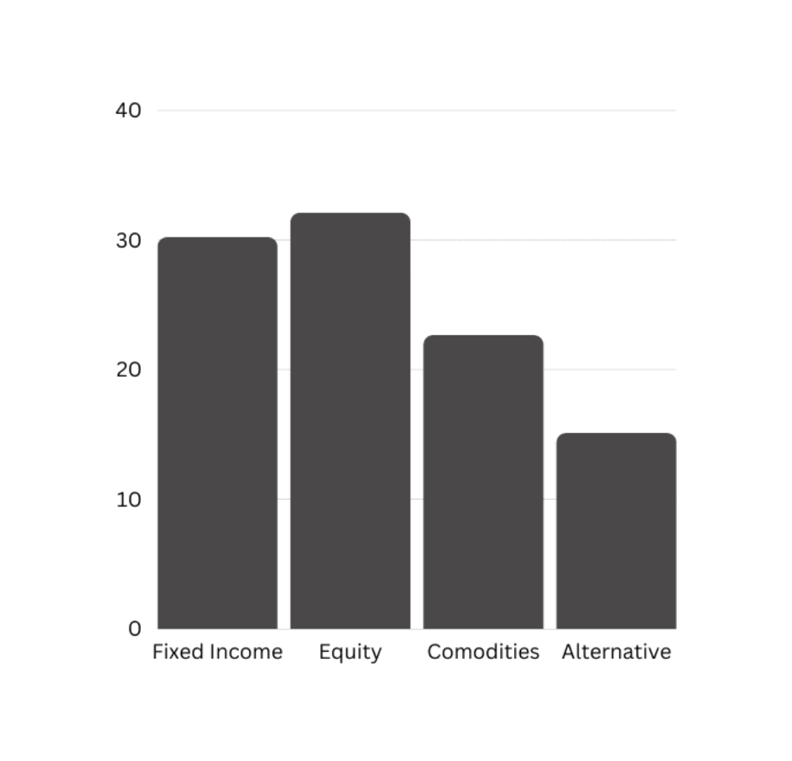

Client 11 Portfolio

Slide 4
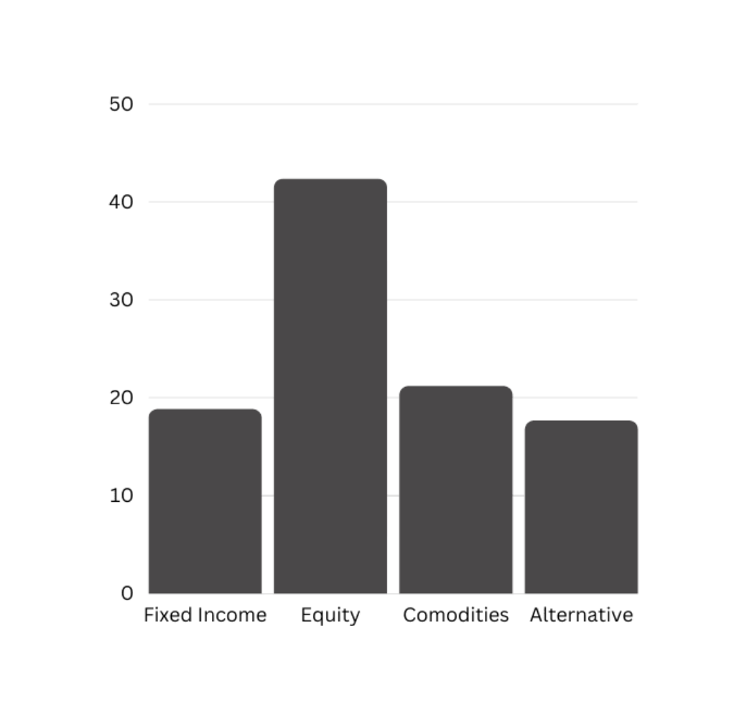
Client 44 Portfolio

Slide 5
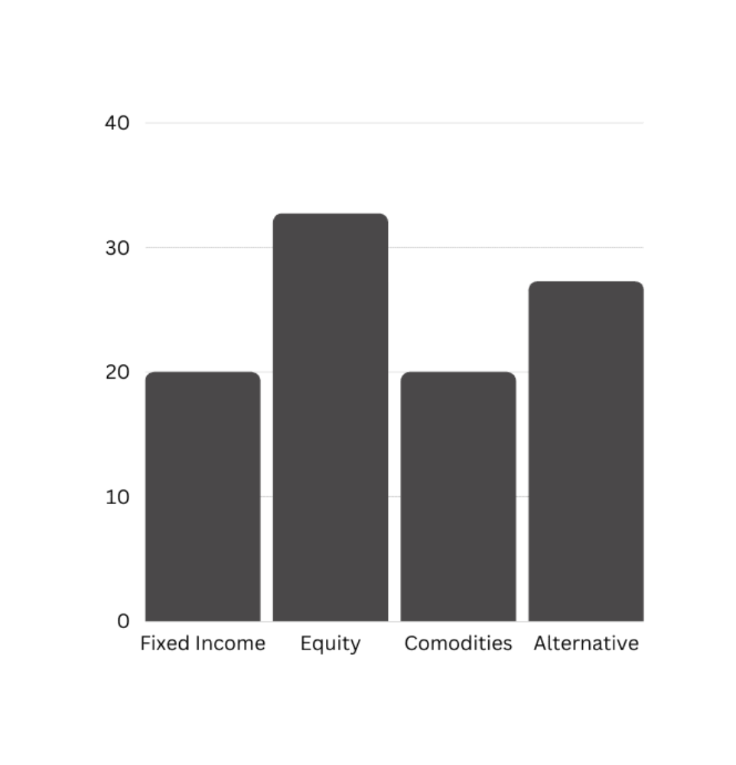

Client 120 Portfolio

Slide 6
Situation Analysis

Slide 7

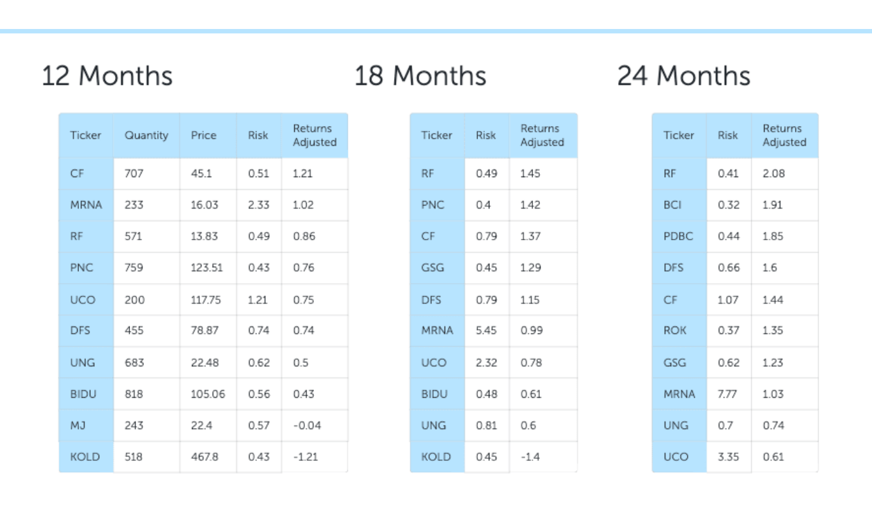
Client 11 Portfolio

Slide 8

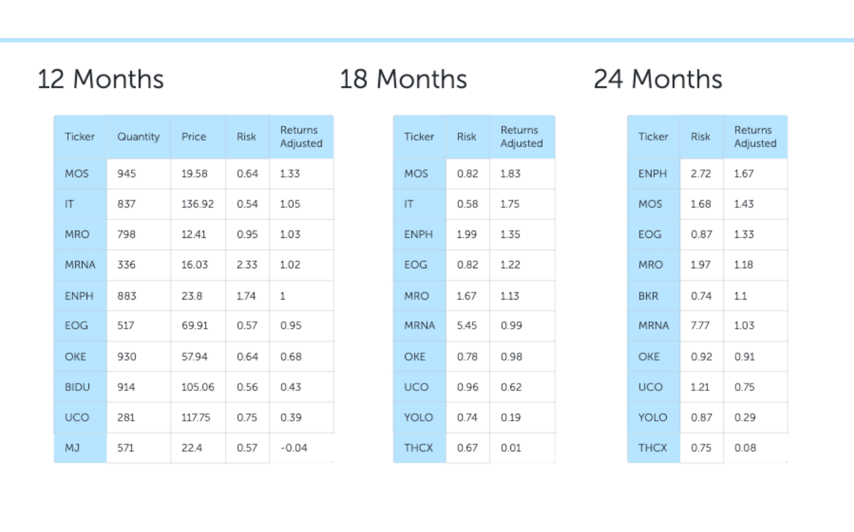
Client 44 Portfolio

Slide 9

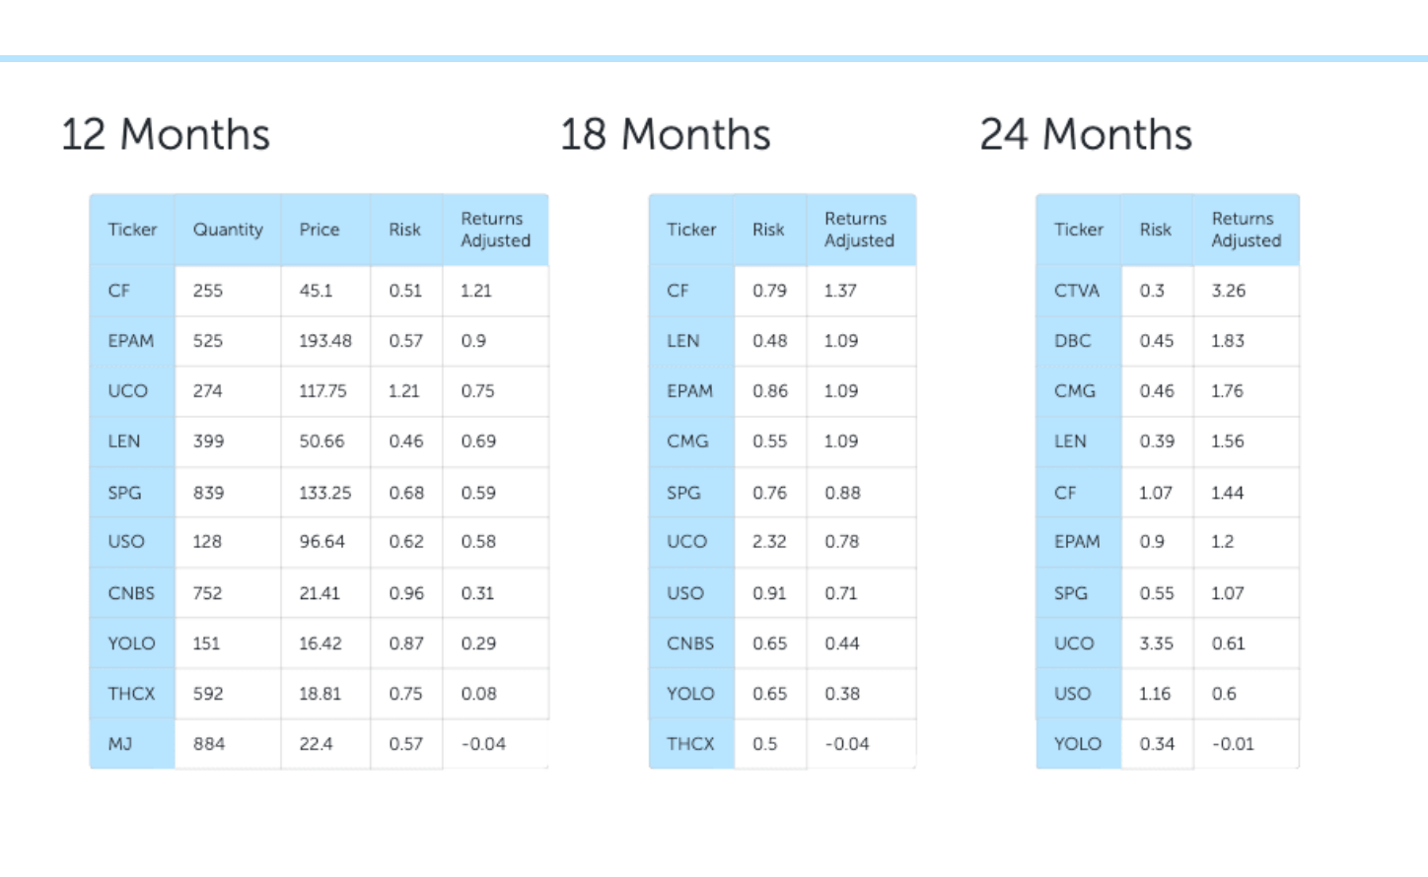
Client 120 Portfolio

Slide 10


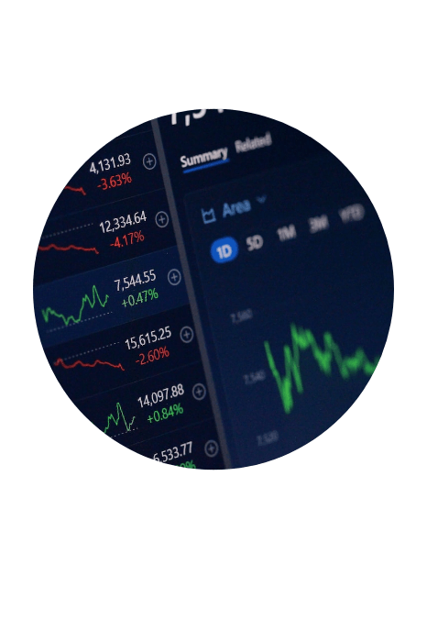

Portfolio Balancing
Clients Risk Appetite
Market Trend Analysis
Risk vs. Returns

Slide 11
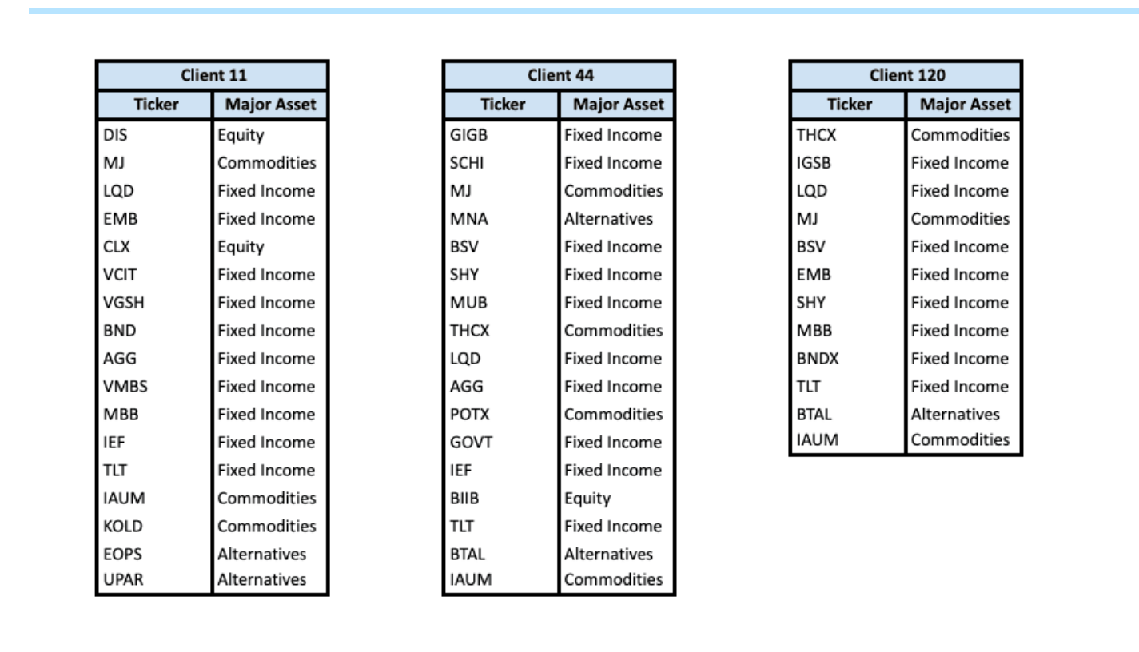

Portfolio Balancing
Selection made based on lowest risk adjusted returns﻿

Slide 12



Key Insights
Most of our clients follow a balance investment strategy.
The Risk Adjusted Return for Fixed income was negative over the 12mo, 18mo, 24 mo period.
Most of the clients has Fixed Income as part of their portfolio that required balancing.
The period under review was during and post the COVID-19 pandemic which may have affected the Risk Adjusted Returns for Fixed Income.

Slide 13

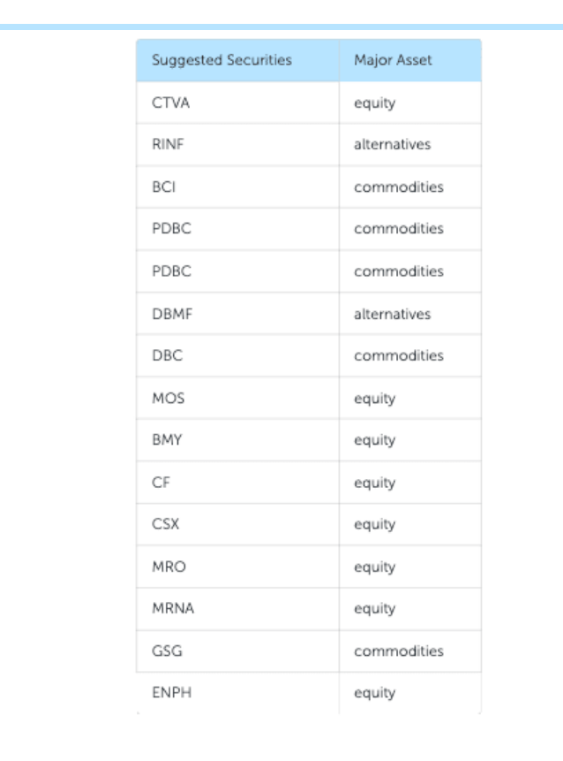

Recommendations
Balance portfolio by buying Equity assets based on the suggested securities

